Slide 1
18MES101L – Engineering Graphics and Design
Exercise – 10
Geometric Dimensioning and Tolerancing (GD&T)

Slide 2
Tolerance
Tolerance is a defined range of measurements or other physical traits that enable the product to function
properly and/or look aesthetically pleasing.
In most cases, the tolerance refers to the minimum or maximum range of measurements of a product in
X, Y, and Z dimensions.
However, you can also express tolerance in terms of color, texture, shape, or profile.
Tolerances are pivotal in the manufacturing process because they will determine how well a part will fit in the final piece and how reliable the final product will be.
Tolerance is the acceptable range for a physical dimension, which is determined by the product designer based on form, fit and function of a part.
Engineers place tolerance on dimensions to allow variances in an acceptable range in order to make a product function properly.

Slide 3
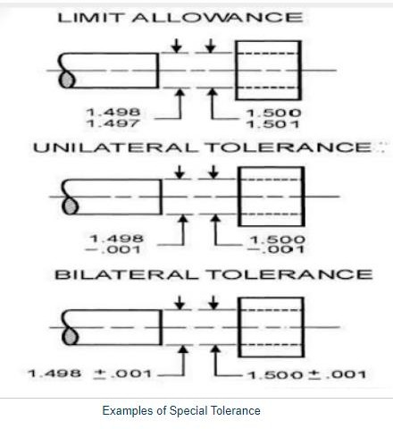
Examples of Tolerance in Engineering Drawing
https://basicstomechanicalengineering.blogspot.com/

Slide 4
Geometric Tolerance
Conventional Or Coordinate Tolerancing System:
Coordinate tolerance is a dimensioning system where a part feature is located (or defined) by means of a rectangular dimension with the given tolerance.
Geometric tolerance of a feature (point, line, axis, surface or medium plane) specifies the tolerance zone within which the feature is required to be contained.
The geometric tolerance feature provides a precise and brief method of indicating brief geometric requirements on engineering drawings. The symbols being internationally been accepted are very useful when overseas manufacture is involved.
Geometric tolerance is very useful especially when conventional dimensioning and drawing methods
are inadequate and doesn’t ensure that parts will assemble satisfactorily after manufacture.
•

Slide 5
Geometric Tolerancing
An engineering drawing may include general tolerances in the form of a table or just a little note somewhere on the drawing.
They can be applied to several conditions, including linear dimensions, angular dimensions, external
radius, chamfer heights, etc.
Geometric Dimensioning and Tolerancing (GDT)
GDT defines the features of a part more efficiently than just the size. It also defines the standards for verifying the specified size and form.
As per standard ASME : ANSI Y14.5-1994
5

Slide 6
Geometric Tolerancing
Geometric tolerances define the shape of a feature as opposed to its size.
We will focus on three basic types of dimensional tolerances:
Form tolerances: straightness, circularity, flatness, cylindricity
Orientation tolerances; perpendicularity, parallelism, angularity
Position tolerances: position, symmetry, concentricity.
A datum is a virtual ideal plane, line, point, or axis. A datum feature is a physical feature of a part identified by a datum feature symbol and corresponding datum feature triangle

Slide 7
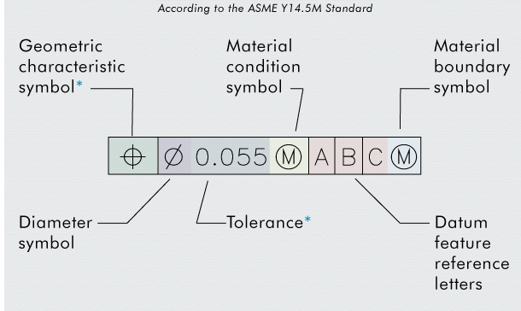

Slide 8
Geometric Tolerances
Feature control boxes (call outs) are used to place geometric tolerances in most drawings. Standard letter height is recommended (1/8-in or 3 mm).
7

Slide 9

















Geometric Tolerances
L LMC….Least Mat’l Cond.
^{M} MMC...Max Mat’l Cond.
^{R} RFS…..Regardless of Feature size.
8

Slide 10
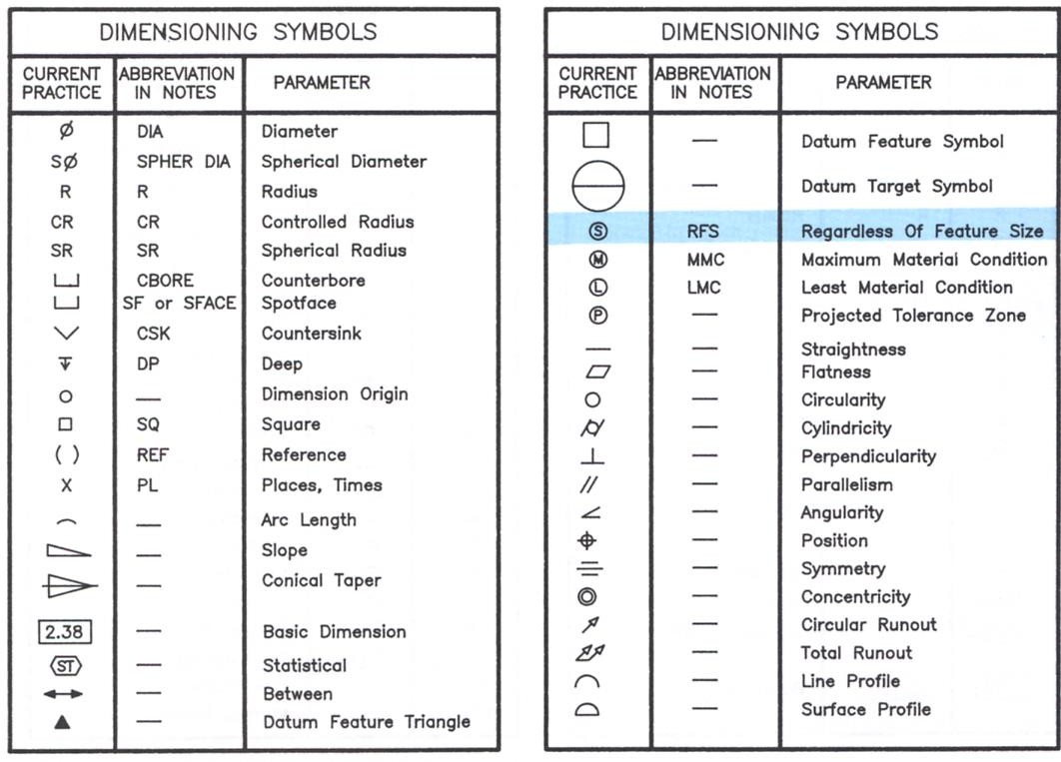
Symbols for Geometric Tolerances
Form
Orientation Position

Slide 11
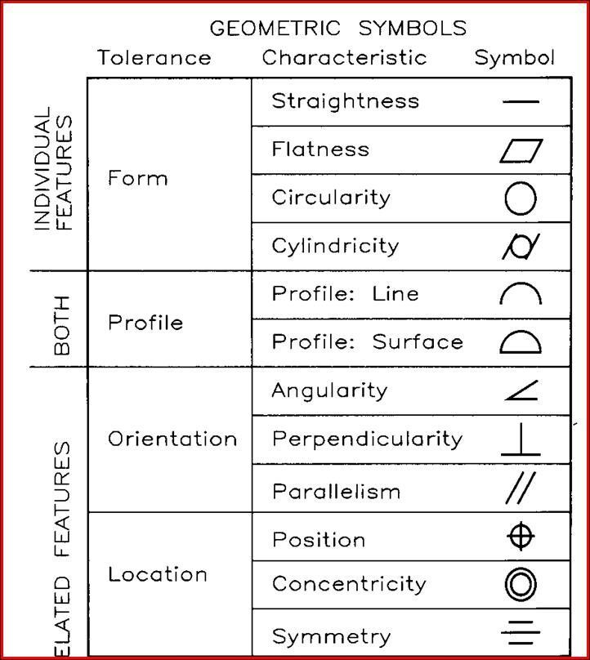
Geometric Tolerancing
Geometric tolerancing is a system that specifies the form, profile, orientation, and location of part’s features using the ANSI standards.
Related features
10

Slide 12
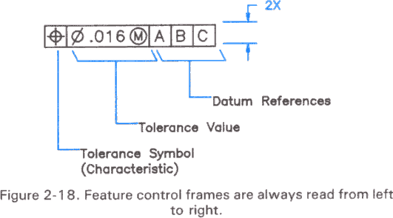
Geometric tolerance…
A geometric tolerance is prescribed using a feature control frame. It has three components:
•
•
•
the tolerance symbol,
the tolerance value,
the datum labels for the reference frame.

Slide 13
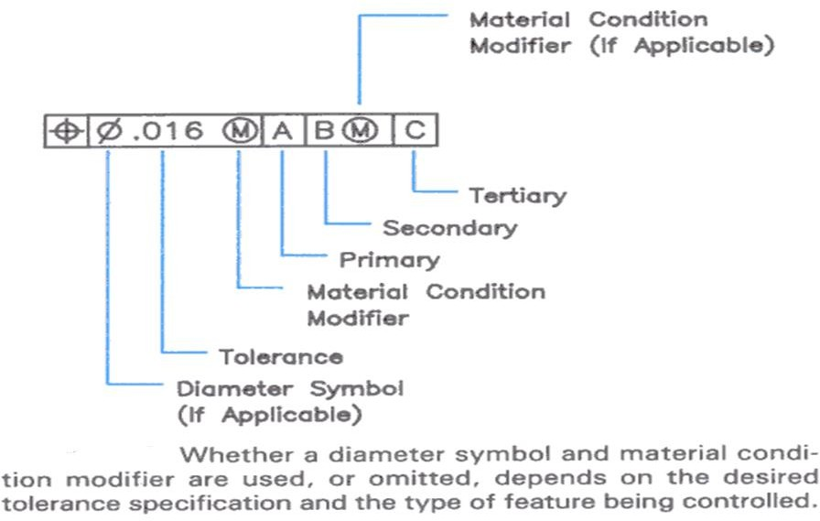
Geometric tolerance…

Slide 14
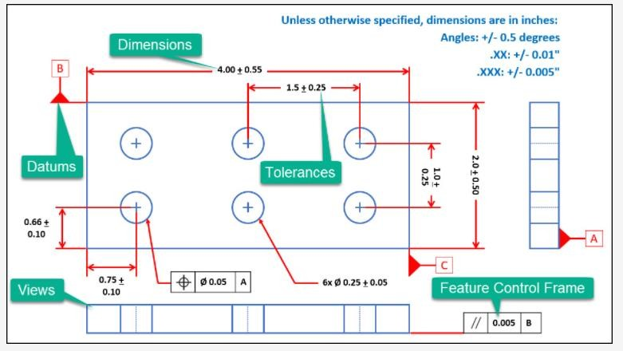
www.cqeacademy.com/cqe-body-of-knowledge/product-process- design/technical-drawings-gdt/

Slide 15
Material condition
Maximum Material Condition (MMC): The condition in which a feature contains the maximum amount of material within the stated limits. e.g. minimum hole diameter, maximum shaft diameter.
Least Material Condition (LMC): The condition in which a feature contains the least amount of material within the stated limits. e.g. maximum hole diameter, minimum shaft diameter
Regardless of Feature Size (RFS): This is the default condition for all geometric tolerances. No bonus tolerances are allowed and functional gauges
may not be used.

Slide 16
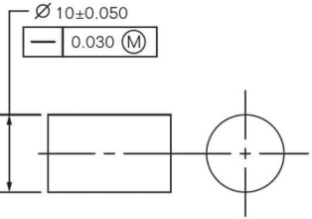
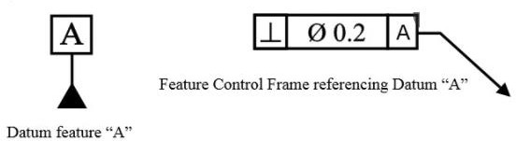
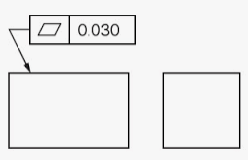
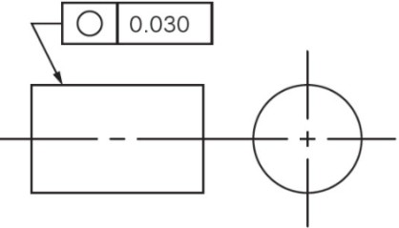
Basic Definitions
Straightness
It is the shortest distance between two points. The tolerance value is the specified distance between two parallel straight lines.
Datum
A datum feature may be a plane or axis. For practical purposes the plane surface or axis is used for manufacture or inspection.
Flatness
Flatness tolerance controls the deviation of the surface from the true plane and is the space between the two parallel planes
Roundness/Circularity
It is the condition where the feature is a continuous curved surface, any point on the surface is at a constant distance from the centre or axis. The roundness tolerance zone is the annular space between two co-planar, concentric circles
.

Slide 17
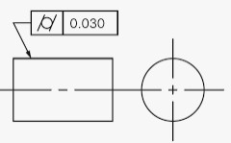
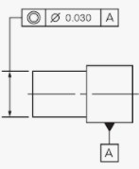
Basic Definitions
Cylindricity
It is a combination of parallelism, straightness and roundness, applied to the surface of a cylinder. The cylindricity tolerance zone is the annular space between two coaxial cylinders and its value is the radial distance between them.
Concentricity
It is the relationship between two cylinders, which have the same axis or common centre.
Concentricity tolerance is the deviation of the axis from the true position.

Slide 18
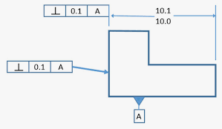
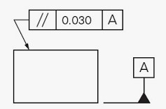
Surface Perpendicularity is a tolerance that controls Perpendicularity between two
90° surfaces, or features. Surface Perpendicularity is controlled with two parallel planes acting as its tolerance zone.
Parallelism
This is the condition where two lines or surfaces are separated by a uniform distance. Parallelism tolerances control the parallelism between the two lines or surfaces and the tolerance zone is the distance between them.

Slide 19
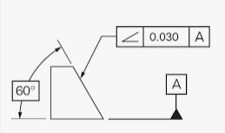
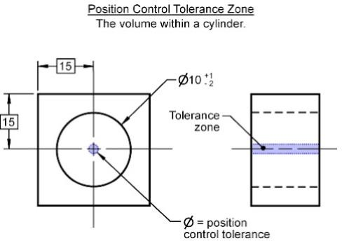
Basic Definitions
Angularity: It defines the position between two lines or surfaces which are nor parallel or perpendicular
to each other.
Position
The positional tolerance controls the position between a feature and a datum or from another feature. The tolerance value is the specified deviation from the true position.

Slide 20
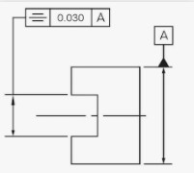
Definitions
Symmetry
It is the feature where a feature is divided into identical parts by means of a line or plane. Symmetry tolerances control the area between the parallel lines or planes, which are parallel to the datum feature, and there value is the distance between them.

Slide 21
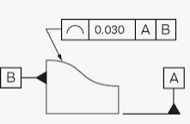
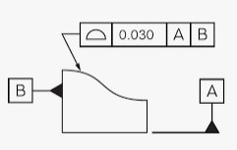
Line: Profile of a line describes a tolerance zone around any line in any feature, usually of a curved shape.
Surface:Profile of a surface describes a 3-Dimensional tolerance zone around a surface, usually which is an advanced curve or shape.

Slide 22
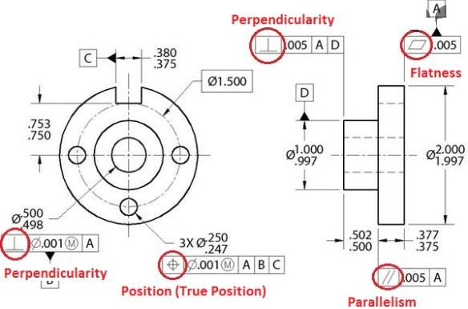
Example

Slide 23
Benefits of Geometric Dimensioning and Tolerancing (GD&T)
Improves Communication:
GD&T can provide uniformity in drawing specification and interpretations, thereby reducing controversy, guesswork and assumptions. Design, production and inspection all in the same language
Provides Better Product Design:
The use of GD&T can improve your product design by providing designers with the tool to “say what they mean” and by following the functional dimensioning philosophy.

